Slide 1
December 26, 2021

Slide 2
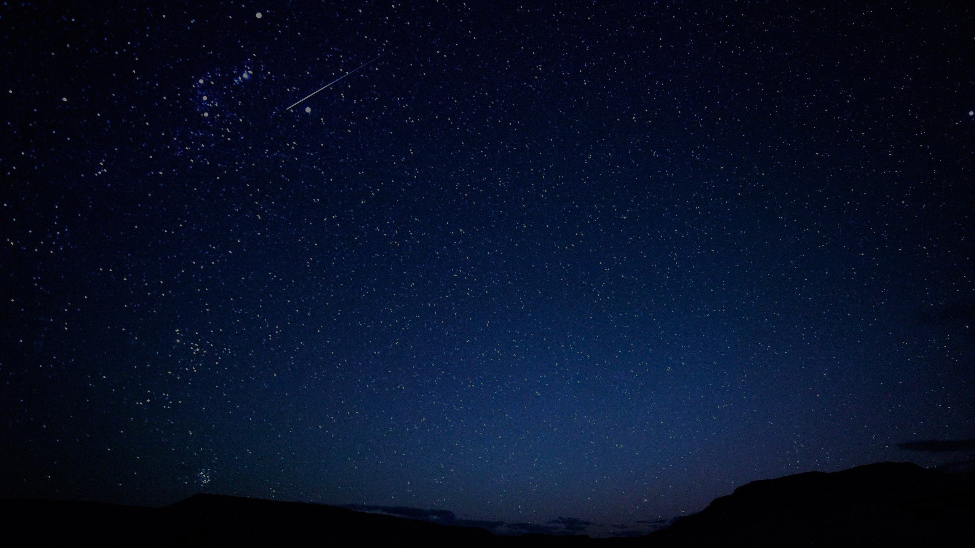
O Come all Ye Faithful
Adeste Fideles
O come all ye faithful joyful and triumphant Oh come ye, O come ye to Bethlehem; Come and behold Him born the King of angels; O come let us adore Him,
O come let us adore Him,
O come let us adore Him, Christ the Lord

Slide 3
O Come all Ye Faithful
Adeste Fideles
God from God, and Light from Light eternal, Lo, He shuns not the virgin’s womb! True God from True God, begotten not created
O come let us adore Him,
O come let us adore Him,
O come let us adore Him, Christ the Lord

Slide 4
O Come all Ye Faithful
Adeste Fideles
Sing choirs of angels sing in exultation Sing all ye citizens of heaven above; Glory to God in the highest: O come let us adore Him,
O come let us adore Him,
O come let us adore Him, Christ the Lord

Slide 5
O Come all Ye Faithful
Adeste Fideles
Yea, Lord, we greet Thee,
Born this happy morning; Jesus, to Thee be all glory given; Word of the Father, now in flesh appearing: O come let us adore Him,
O come let us adore Him,
O come let us adore Him, Christ the Lord

Slide 6
O Come all Ye Faithful
Adeste Fideles
O come all ye faithful joyful and triumphant Oh come ye, O come ye to Bethlehem; Come and behold Him born the King of angels; O come let us adore Him,
O come let us adore Him,
O come let us adore Him, Christ the Lord

Slide 7
Colossians 3:16
Let the word of Christ richly dwell within you, with all wisdom teaching and admonishing one another with psalms and hymns and spiritual songs, singing with thankfulness in your hearts to God.

Slide 8
Jesus is King
O come all ye faithful joyful and triumphant O come ye, O come ye to Bethlehem; Come and behold Him born the King of angels;

Slide 9
Revelation 4:5-8
5 Out from the throne come flashes of lightning and sounds and peals of thunder. And there were seven lamps of fire burning before the throne, which are the seven Spirits of God; 6 and before the throne there was something like a sea of glass, like crystal; and in the center and around the throne, four living creatures full of eyes in front and behind. 7 The first creature was like a lion, and the second creature like a calf, and the third creature had a face like that of a man, and the fourth creature was like a flying eagle. 8 And the four living creatures, each one of them having six wings, are full of eyes around and within; and day and night they do not cease to say, "HOLY, HOLY, HOLY is THE LORD GOD, THE ALMIGHTY, WHO WAS AND WHO IS AND WHO IS TO COME."

Slide 10
Isaiah 6:1-3
1 In the year of King Uzziah's death I saw the Lord sitting on a throne, lofty and exalted, with the train of His robe filling the temple. 2 Seraphim stood above Him, each having six wings: with two he covered his face, and with two he covered his feet, and with two he flew. 3 And one called out to another and said, "Holy, Holy, Holy, is the Lord of hosts, The whole earth is full of His glory."

Slide 11
Jesus is King
O come all ye faithful joyful and triumphant O come ye, O come ye to Bethlehem; Come and behold Him born the King of angels;

Slide 12
Jesus is God
God from God, and Light from Light eternal, Lo, He shuns not the virgin’s womb! True God from True God, begotten not created

Slide 13
The Council of Nicaea 325 AD
We believe in one God, the Father Almighty, Maker of all things visible and invisible.
And in one Lord Jesus Christ, the Son of God, begotten of the Father, the only-begotten; that is, of the essence of the Father, God of God, Light of Light, very God of very God, begotten, not made, being of one substance with the Father; by whom all things were made both in heaven and on earth…

Slide 14
Jesus is God
God from God, and Light from Light eternal, Lo, He shuns not the virgin’s womb! True God from True God, begotten not created

Slide 15
Hebrews 2:9-10
9 But we do see Him who was made for a little while lower than the angels, namely, Jesus, because of the suffering of death crowned with glory and honor, so that by the grace of God He might taste death for everyone. 10 For it was fitting for Him, for whom are all things, and through whom are all things, in bringing many sons to glory, to perfect the author of their salvation through sufferings.

Slide 16
Romans 10:9-10
that if you confess with your mouth Jesus as Lord, and believe in your heart that God raised Him from the dead, you will be saved;

Slide 17
Jesus is Exalted
Sing choirs of angels sing in exultation Sing all ye citizens of heaven above; Glory to God in the highest:

Slide 18
Philippians 3:20
For our citizenship is in heaven, from which also we eagerly wait for a Savior, the Lord Jesus Christ;

Slide 19
Revelation 5:1-5
1 I saw in the right hand of Him who sat on the throne a book written inside and on the back, sealed up with seven seals. 2 And I saw a strong angel proclaiming with a loud voice, "Who is worthy to open the book and to break its seals?" 3 And no one in heaven or on the earth or under the earth was able to open the book or to look into it. 4 Then I began to weep greatly because no one was found worthy to open the book or to look into it; 5 and one of the elders said to me, "Stop weeping; behold, the Lion that is from the tribe of Judah, the Root of David, has overcome so as to open the book and its seven seals."

Slide 20
Revelation 5:6-8
6 And I saw between the throne (with the four living creatures) and the elders a Lamb standing, as if slain, having seven horns and seven eyes, which are the seven Spirits of God, sent out into all the earth. 7 And He came and took the book out of the right hand of Him who sat on the throne. 8 When He had taken the book, the four living creatures and the twenty-four elders fell down before the Lamb, each one holding a harp and golden bowls full of incense, which are the prayers of the saints.

Slide 21
Revelation 5:9-10
9 And they sang a new song, saying, "Worthy are You to take the book and to break its seals; for You were slain, and purchased for God with Your blood men from every tribe and tongue and people and nation. 10 "You have made them to be a kingdom and priests to our God; and they will reign upon the earth."

Slide 22
Revelation 5:11-14
11 Then I looked, and I heard the voice of many angels around the throne and the living creatures and the elders; and the number of them was myriads of myriads, and thousands of thousands, 12 saying with a loud voice, "Worthy is the Lamb that was slain to receive power and riches and wisdom and might and honor and glory and blessing." 13 And every created thing which is in heaven and on the earth and under the earth and on the sea, and all things in them, I heard saying, "To Him who sits on the throne, and to the Lamb, be blessing and honor and glory and dominion forever and ever." 14 And the four living creatures kept saying, "Amen." And the elders fell down and worshiped.

Slide 23
Jesus is Glorious
Yea, Lord, we greet Thee, born this happy morning; Jesus, to Thee be all glory given; Word of the Father, now in flesh appearing:

Slide 24
John 1:1-9
1 In the beginning was the Word, and the Word was with God, and the Word was God. 2 He was in the beginning with God. 3 All things came into being through Him, and apart from Him nothing came into being that has come into being. 4 In Him was life, and the life was the Light of men. 5 The Light shines in the darkness, and the darkness did not comprehend it. 6 There came a man sent from God, whose name was John. 7 He came as a witness, to testify about the Light, so that all might believe through him. 8 He was not the Light, but he came to testify about the Light. 9 There was the true Light which, coming into the world, enlightens every man.

Slide 25
John 1:10-14
10 He was in the world, and the world was made through Him, and the world did not know Him. 11 He came to His own, and those who were His own did not receive Him. 12 But as many as received Him, to them He gave the right to become children of God, even to those who believe in His name, 13 who were born, not of blood nor of the will of the flesh nor of the will of man, but of God. 4 And the Word became flesh, and dwelt among us, and we saw His glory, glory as of the only begotten from the Father, full of grace and truth.

Slide 26
2 Corinthians 4:6
For God, who said, "Light shall shine out of darkness," is the One who has shone in our hearts to give the Light of the knowledge of the glory of God in the face of Christ.

Slide 27
December 26, 2021

